Slide 1
Cosine Ratio
EQ: How do I find missing side lengths using Sine Ratio?

Slide 2
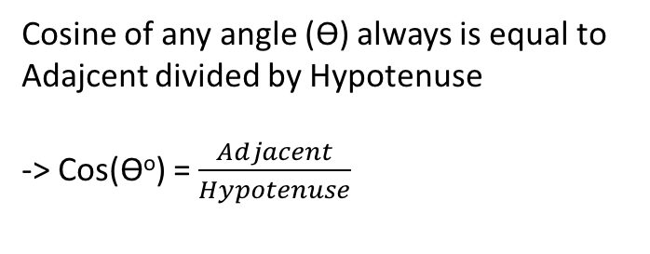
24
7
30
Sine Ratio
EQ: How do I find missing side lengths using Sine Ratio?
Cosine Ratio is used when you have the Hypotenuse and Adjacent sides on a right angle triangle.
Remember- the hypotenuse is the longest side on the triangle, and is always opposite from the right angle. The adjacent is the side next to the angle.
Hypotenuse
Cosine of any angle (ϴ) always is equal to Adajcent divided by Hypotenuse
-> Cos(ϴº) = $\frac{Adjacent}{Hypotenuse}$
ϴ
Adjacent

Slide 3
Cosine- Variable above the number
EQ: How do I find missing side lengths using Cosine Ratio?
1- Label the sides
2- Write the equation as Cos(47) = y/14 – y is the adjacent length and 14 is the hypotenuse length.
3- Because the 14 is below the y, we multiply both side by 14 to isolate y.
4- Write the new equation as 14xCos(47) = y
5- Use your calculator to solve 14xCos(47)
6- y = 9.5479…*round to 2 dp* -> 9.55m
14 m
Hypotenuse
47º
Y m
Adjacent

Slide 4
Cosine – Variable below the number
EQ: How do I find missing side lengths using Cosine Ratio?
1- Label the sides
2- Write the equation as Cos(32) = 13/z – z is the Hypotenuse length and 13 is the opposite length.
3- Because the z is below the 13, we swap the ratio with the variable.
4- Write the new equation as 13/Cos(32) = z
5- Use your calculator to solve 13/cos(32)
6- z = 15.3294…*round to 2 dp* -> 15.33m
Z m
Hypotenuse
KEY NOTES: if Z is smaller than the number you used, you did something wrong – Z should be the biggest number because it is the hypotenuse.
32º
13 m
Adjacent

Slide 5
Key information from yesterday
When the number is below the variable – Multiply both sides by the Variable. [TIMES]
When the number is above the variable – Divide the number by (Ratio x Angle). [SWAP]

Slide 6
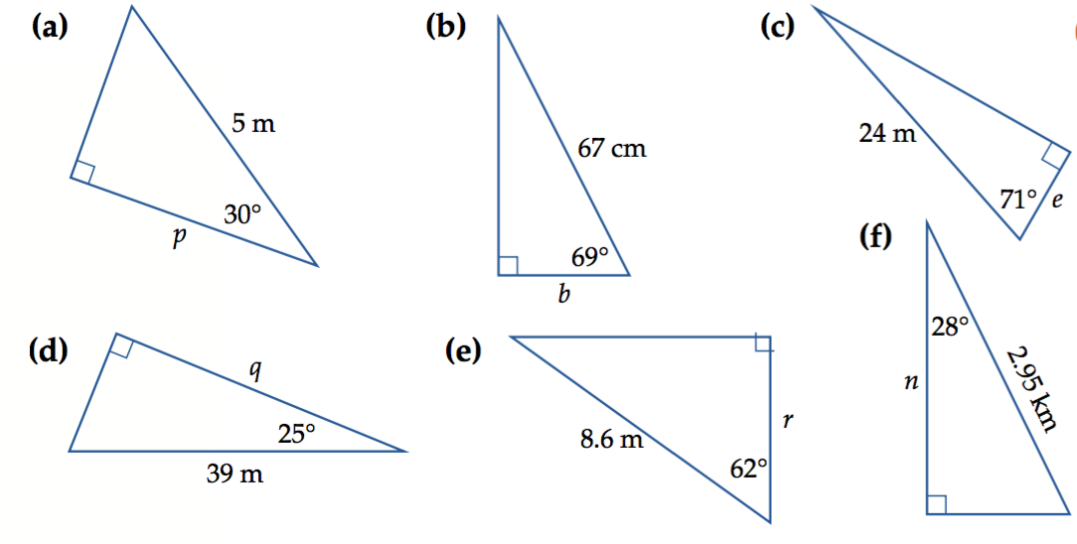
Practise

Slide 7
ANSWERS
cos(30) = p/5
5 x cos(30) = p
4.33 = p
b. cos(69) = b/67
67 x cos(69) = b
24.01 = b
c. Cos (71) = e/24
24 x cos(71) = e
7.81 = e
d. cos(25) = q/39
39 x cos(25) = q
35.35 = q
e. cos(62) = r/8.6
8.6 x cos(62) = r
4.04 = r
f. cos(28) = n/2.95
2.95 x cos(28) = n
2.60 = n

